Slide 1
Colonel George Iles 1918 – 2004 What’s Behind the name
Material submitted by his son,
Daniel lles, and Nephew, Tighe Bronaugh

Slide 2
Early Life in Quincy, IL Born to Mr. and Mrs. George J. Iles
Born 1918
Lincoln (segregated) Elementary School
Quincy High School – graduated 1935
Quincy College – left studies to enlist in 1942. Went to Tuskegee Air Force Base
Had obtained Pilot’s License –
First African-American to do so
from Quincy, IL)

Slide 3
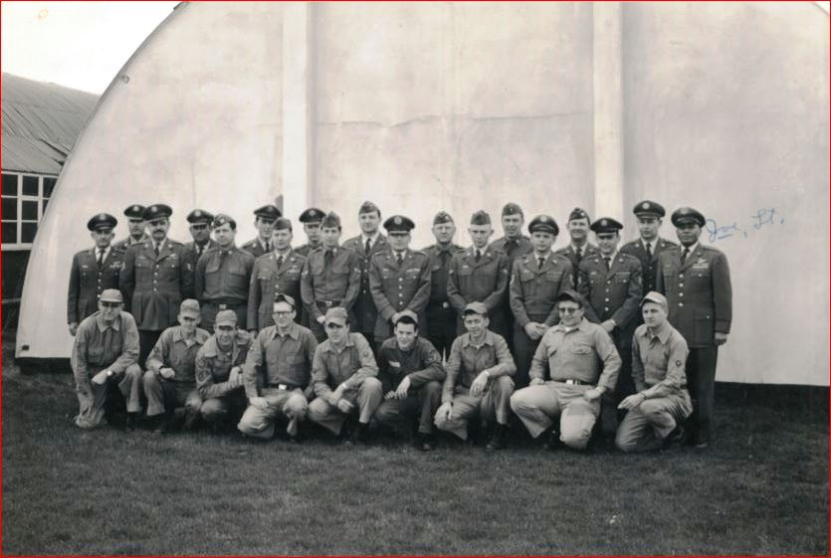
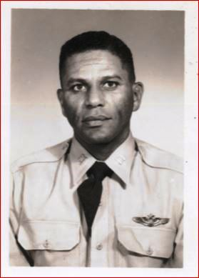
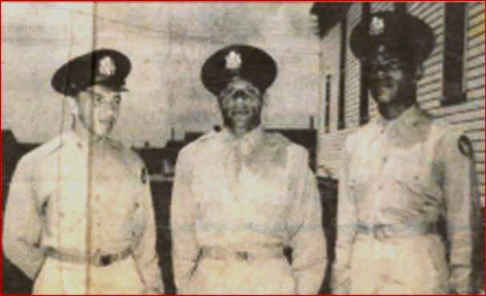
George Iles, 2nd LT, 1944 (His Squadron, Friends, and Portrait.

Slide 4
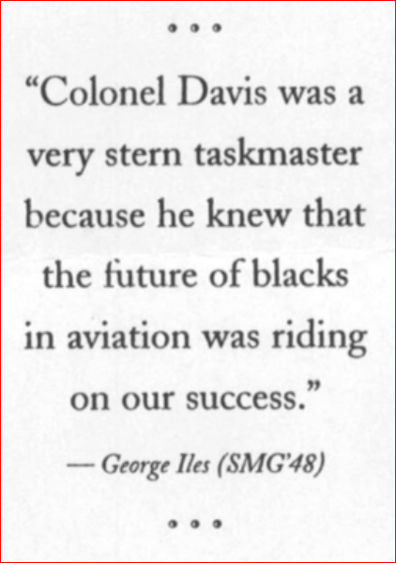
Guiding PRINCIPLES: (from Tuskegee Officer in Charge and Iles’ Personnel Creed
* * *
Duty and service first to our Country:
so that we could improve and progress as a People.
* * *

Slide 5
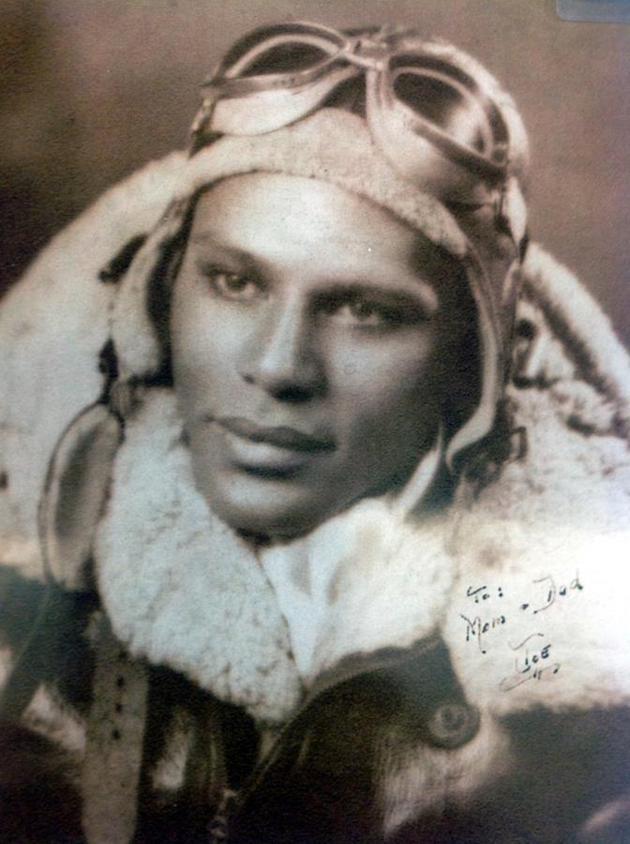
WAR RECORD
Participated in 23 Missions over Germany
Shot Down in February, 1945
POW for 3 months

Slide 6
Career * INTELLIGENCE Training for reconnaissance * Korean War * Japanese Base for post-Korean War surveillance * Viet Nam * Flight Trainer; Espionage Trainer.

Slide 7
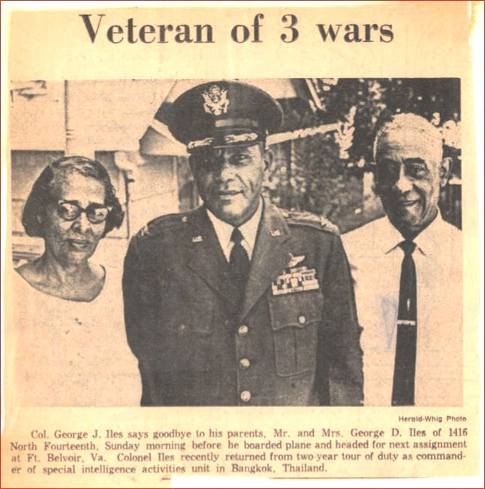
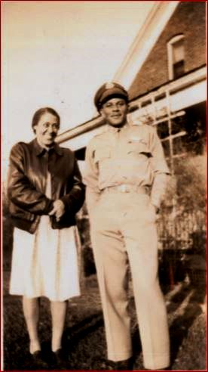
Married twice – 2 sons
* Cornelia Iles of Quincy, and later Yola Iles of Holland
* Bruce Adrian Iles and Daniel Iles

Slide 8
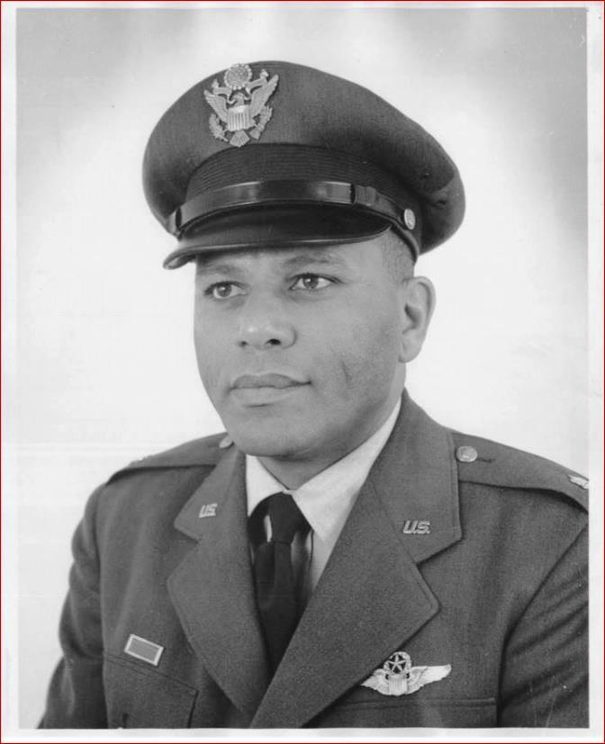
Volunteered in Viet Nam after the death of his Son, Bruce, in Da Nang

Slide 9
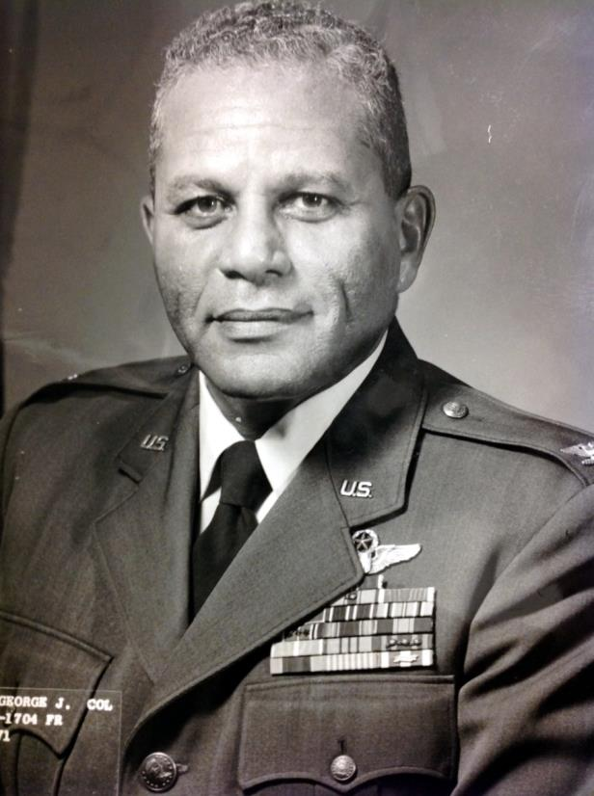
Died in 2004 afteR establishing the Iles Foundation for Children
Colonel George Iles

Slide 10
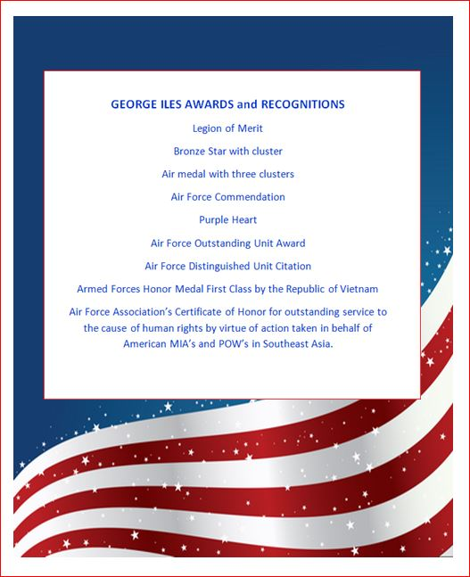
The 332 Pilots won over 850 medals and awards for their Service in WWII and paved the way for Armed Services Integration in 1948.
(Executive Order
9981).

Slide 11
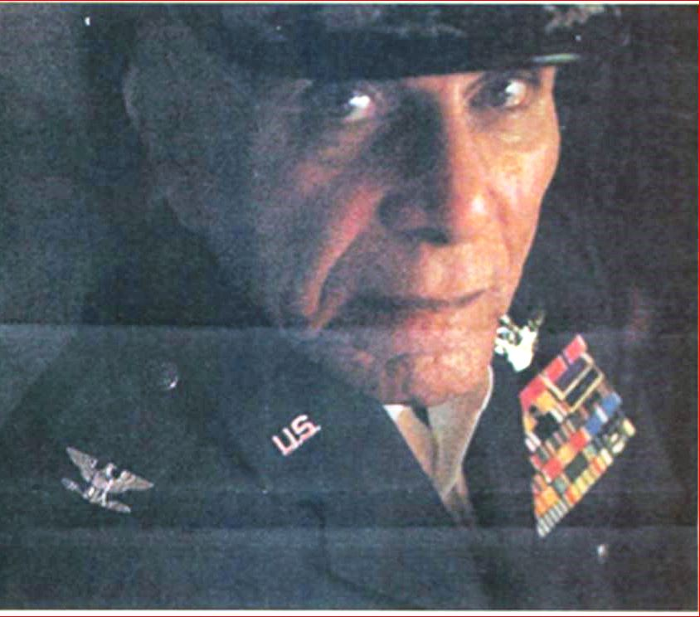
Colonel George Iles, Patriot, Hero, Trail Blazer for African-Americans and Our Whole Country.

